Slide 1
Humanoid Stability Analysis Based on Impact Location and Intensity
Thesis proposal
samia choueiri
Supervised by: dr. hassan diab
Notes:
Hello Everyone, my name is samia choueiri and I present to you my thesis topic proposal entitle “humanoid stability analysis based on impact location, intensity and supervised by Dr. Hassan Diab.

Slide 2
Outline
Introduction
Statement of the Problem
Literature Review
Thesis Objectives
Methodology Of The Work
Humanoid Modeling
Motion Analysis
Stability Under Disturbances
Disturbance Evaluation with Sensors
Disturbance Evaluation without Sensors
Stability Control Algorithm
Notes:
I will be briefly introducing the topic and stating the problems to be tackled. I will be listing the different topics studied in this field till now, how the problems were dealt with by others and then my approach toward the solution in the different sectors.

Slide 3
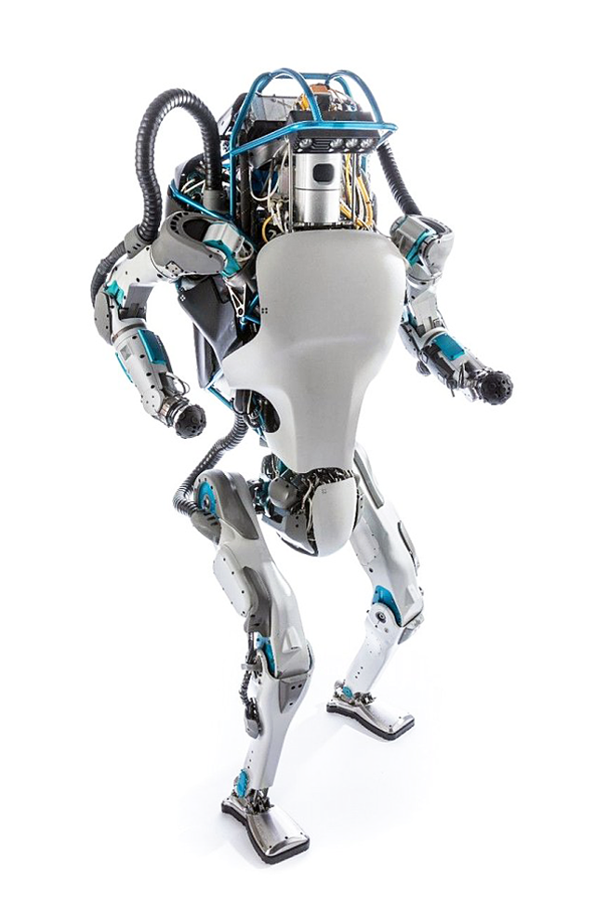
Introduction
Humanoid
Human-like Structured Autonomous Robot
Adapts to Changes
Takes Decisions
Performs Tasks
Notes:
I would like to start with introducing what a humanoid is. A humanoid is human-like robot, and when we say robot, then it have to be a machine that is definitely autonomous, so it can not be controlled or manipulated. It should also be able to acquire information from its surrounding to detect changes and adapt to them by taking the appropriate decision to perform a diversity of tasks.
What you see in the figure here is a humanoid robot called atlas that was designed and assembled in Boston Dynamics. Its a 1.8-meter humanoid designed for a variety of search and rescue tasks.

Slide 4
Statement of the Problem
Movement
Perception
Decision
Notes:
There are three main problem to tackle when it comes to stabilizing a humanoid which aim at giving the robot characteristics similar to humans.
So we aim at stabilizing and controlling the movement of a robot and help it walk through a control mechanism that allows it to move smoothly and in a robust way as close to that of humans’
We also aim at increasing the sense of consciousness of the robot by acquiring information from it’s surrounding. It is very important for a robot to be aware of itself and the environment it’s in specially the contact surface and external forces that cause instability.
It should also take the most appropriate decisions after analyzing the information acquired from its surrounding.

Slide 5
Literature Review
Kinematics Model
Dynamics Model
Motion Analysis and Control
Notes:
Concerning what has been done in this field till now, we have models that describe the architecture of robots with the mass and geometric characteristics and also the type and size of each link and joint.
First the kinematic model which demonstrates the movement and displacement of the links of a robot with respect to each other.
The dynamics model representing the velocity and the force at the end of each link.
The motion analysis is used to study the motion of the robot and the location of its contact edges with the ground with respect to the center of mass . In case of instability many control algorithms have been implemented to control the movement and the speed of the robot ensuring its stability at the same time.
1- Design of Humanoid Robot Stable Walking Using Inverse Kinematics and Zero Moment
Point Ario Sunar Baskoro, Mark Gabriel Priyono Department of Mechanical Engineering, Faculty of Engineering University of Indonesia Indonesia
2- Estimation of Contact Forces and Floating Base Kinematics of a Humanoid Robot Using Only Inertial
Measurement Units Alexis Mifsud1;2 , Mehdi Benallegue1;2 and Florent Lamiraux1;2
3- Analysis of Path Planning of Humanoid Robots using Neural Network Methods
and Study of Possible use of Other AI Techniques

Slide 6
Literature Review
Perception of Events
Decision Making
Notes:
The perception of events has always been studied for robots to be able to detect and be aware of impact and external forces and also acquire information about the environment and the robot would make the best decision and converge to the optimal solution through deep learning algorithms

Slide 7
Thesis objectives
Increase Motion Stability Under Disturbances
Enhance Perception of Events with and without sensors
Taking the best Decision
Notes:
Therefore making the three problems stated previously my main concern and making use of the work that has been done until now, I propose the following solutions.
First a humanoid model will have to be stabilized under disturbances and external forces which is the main cause of a humanoid’s instability. So mainly the humanoid’s movement and motion will have to be analyzed and then controlled.
Next the robot should be able to collect data about itself and its surrounding precisely from its contact surface with the ground to prevent slipping and stumbling. but we will be mainly contributing in the analysis and evaluation the external impact force that can lead the robot to lose control of its posture and movement.
If the external force is evaluated and analyzed the repose on the posture or motion control system will definitely save the situation better and this will have to go into machine and deep learning algorithms, therefore the system will be taking the best decision.

Slide 8
Methodology of the Work
Motion Analysis
Stability Under Disturbances
Disturbance Evaluation with Sensors
Disturbance Evaluation without Sensors
Stability Control Algorithm
Humanoid Modeling
Notes:
The titles listed here in this slide form a road map that will lead to the targets that I was just discussing in the previous slide.

Slide 9



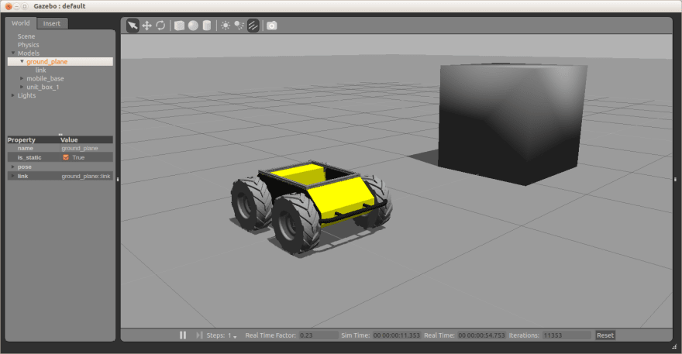
Humanoid Modeling
Choice of Robot
Visualization and Modeling
Virtual Prototyping in Real Conditions
Notes:
First of all a robot will have to be chosen and on which all the simulation and data analysis will be in practice. Each model has unique mass and geometric parameters that have to be extracted to be used in the calculations. These parameter describe the robot link and joint characteristics, dimensions, types and mass.
In this research I will be using ROS the Robot Operation System as a platform in Ubuntu from linux, were I will be visualizing the humanoid in a virtual space and observe its movement
I will also be using Gazeebo which is virtual prototyping software in real conditions.
It will allow us to visualize the robot and also observe its behavior is real conditions such as being subject to an impact force.

Slide 10
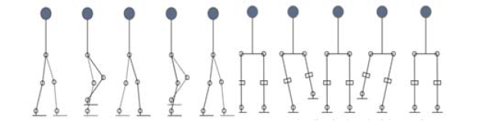
Motion Analysis and Control
Use Geometric and Mass Parameters
Formation of the Mathematical Model
Implementation of the Kinematic and Dynamic Model
Notes:
From the mass and geometric parameters used previously, I will have to define the mathematical models from which all calculations will start and leading me to the kinematic and the dynamic models. They both contribute in studying the displacement and movement of the robot using the displacement, velocity and acceleration of all joints and links with respect to each other in a sequential way forming the robot’s movement. The speed of the robot is a good characteristic of the humanoid but it has to be optimized in order to ensuring its stability at the same time.

Slide 11
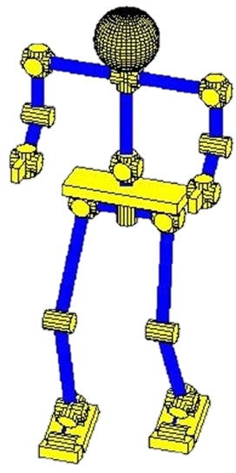
Stability Under Disturbances
Main Causes of Instability
Study of the Effects of an Impact Force
Types of Control to be Used
Diversity of Impact force
External Force
Center of Gravity
Contact Polygon
ZMP
Notes:
Using the kinematic and the dynamic model, the stabilization of the humanoid will be done taking the main cause and trigger of instability as a primary concern.
A very important cause of a robot to loose stability and control is an external impact force, where its effect is mainly to push the projection of the Zero moment point of the robot away from its contact polygon remarkably exceeding a threshold.
The most suitable type of control to be used will have to be selected taking into consideration how different the impact force can be.

Slide 12
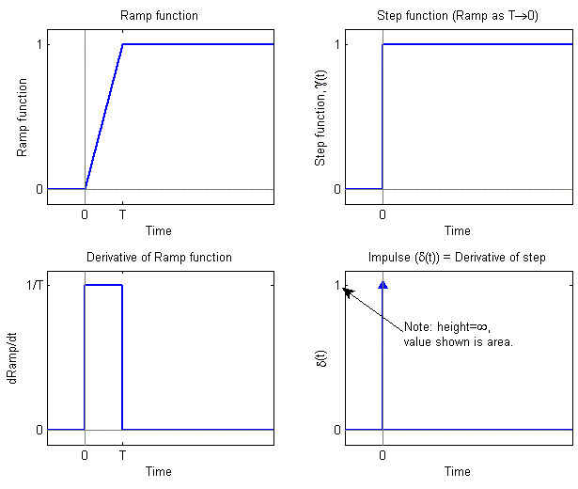
Disturbance Evaluation w/wo Sensors
Increases the consciousness of the System
Enhance the Response of the System
Reduce Number of Sensors Used
Position
Intensity
Time Duration
Notes:
So this will help the humanoid to have a sense of differentiation and increase its consciousness and awareness to the its surrounding.
The impact evaluation will inform us with the position of the impact force, its intensity and its time duration. These parameters will give the disturbance its identity. The four graphs show four different examples of signals that can also represent the state of the evaluated impact force.
If the system acquires this information about the impact it will be responding in a way to compensate and pay off the instability specifically.
This will be applied with the use of pressure sensors and also without them. Instead we will be looking at the rotation angle, velocity and acceleration at each joint and link. These observations will go in a machine learning algorithm in which the disturbance is evaluated and the control system will compencate accordingly.

Slide 13
Stability Control Algorithm
Motion Control
Stability Under Disturbances
Disturbance Evaluation
Response
Notes:
And then putting all these together in one algorithm will for a stability control algorithm which will be taking care of the posture , the balance, the motion robustness and also give a sense of consciousness to the humanoid leading to a faster and a more educated response to impact forces and disturbances.

Slide 14
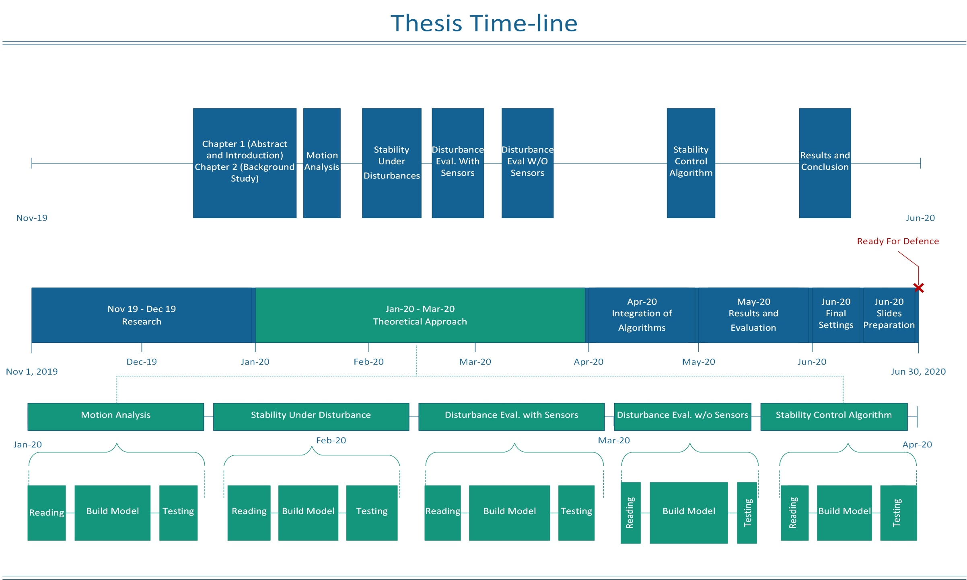
Notes:
Finally, this is the current and future plan that I am willing to follow to finish my thesis by the end of next semester. This time line includes first a research followed by reading, building and testing the different model. Next the algorithms will be integrated to extract the results that will be then evaluated. In parallel each step of the work will be reported in a chapter of my thesis report.

Slide 15
Thank You

